Slide 1

Diamond Price Predictive Modeling
Chengxi Zhang, Dafu Zhang,
Xichang Dong, Zhenming Yang

Slide 2

Current Situation
Limit of effective tools
Big mount and increasing dataset
Many filters conditions

Slide 3

Our Mission
Develop a model based on R language to help them to predict the trend of price fluctuation for diamond

Slide 4


Tools and Environment
Win7 x64 16G RAM INTEL E3-1230 v3
R 3.3.3(R studio)
Phantomjs-2.1.1

Slide 5
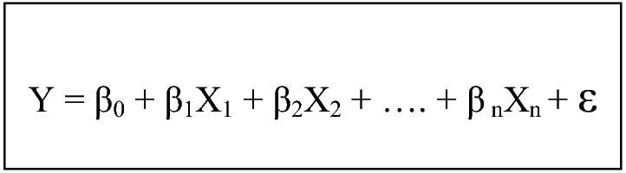
Predictive Models
Multiple Linear Regression
Decision Trees
Random Forests

Slide 6
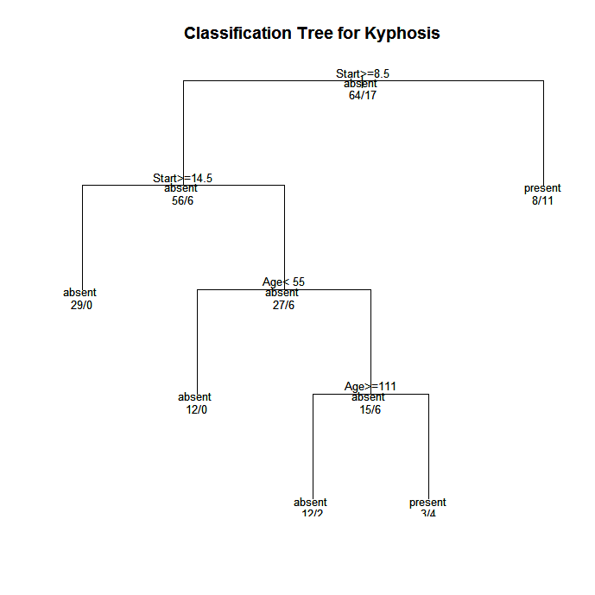
Predictive Models
Multiple Linear Regression
Decision Trees
Random Forests

Slide 7
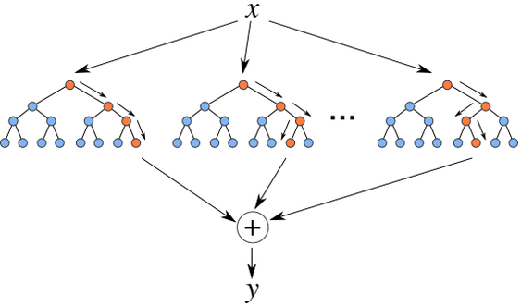
Predictive Models
Multiple Linear Regression
Decision Trees
Random Forests

Slide 8
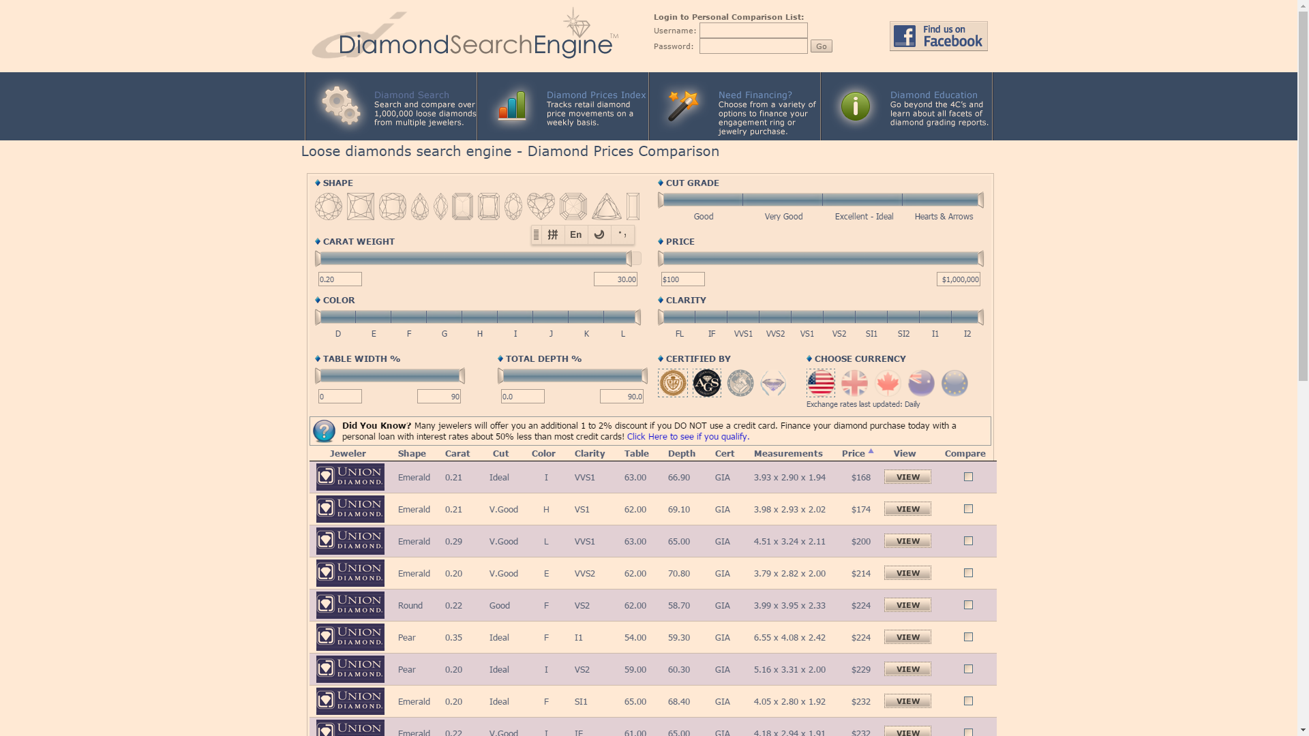
Scraping Data
open network
Ask new AJAX request
Analyze and obtain aimed address

Slide 9
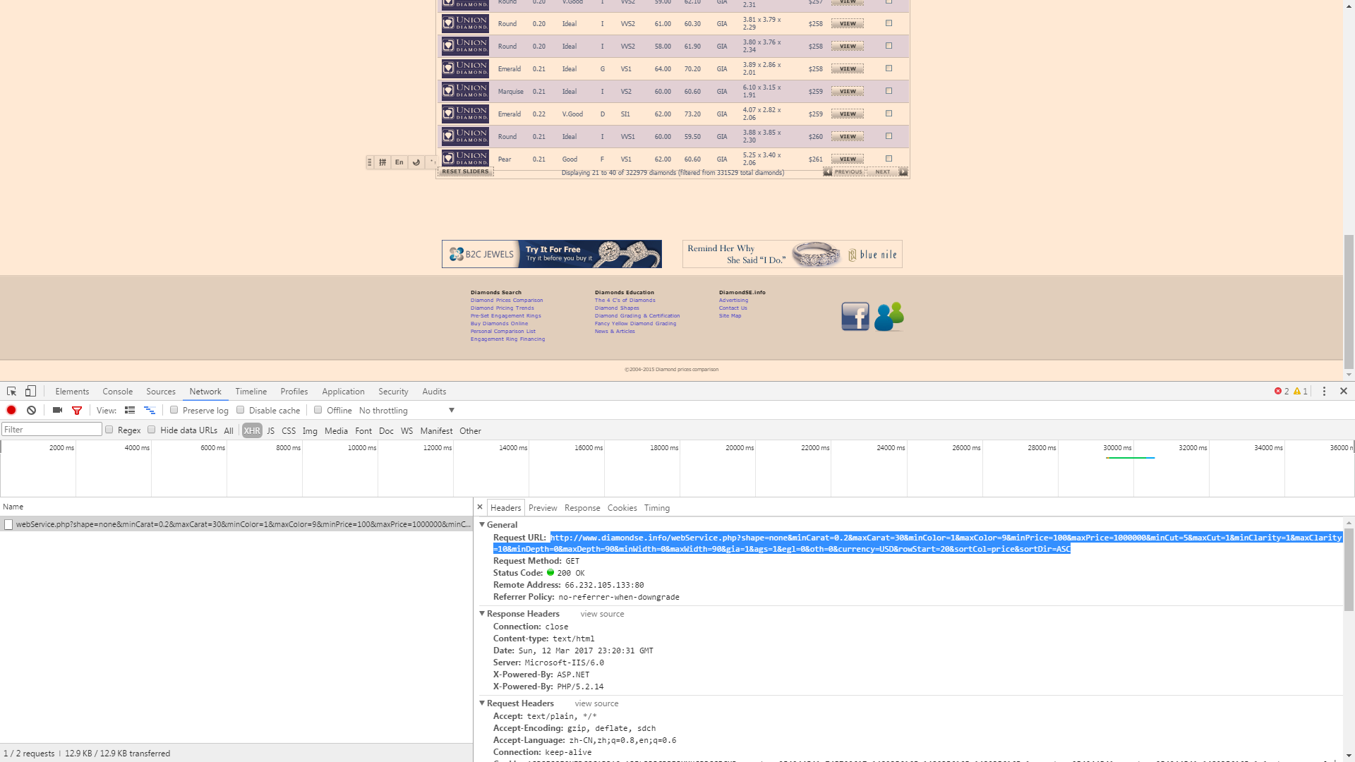
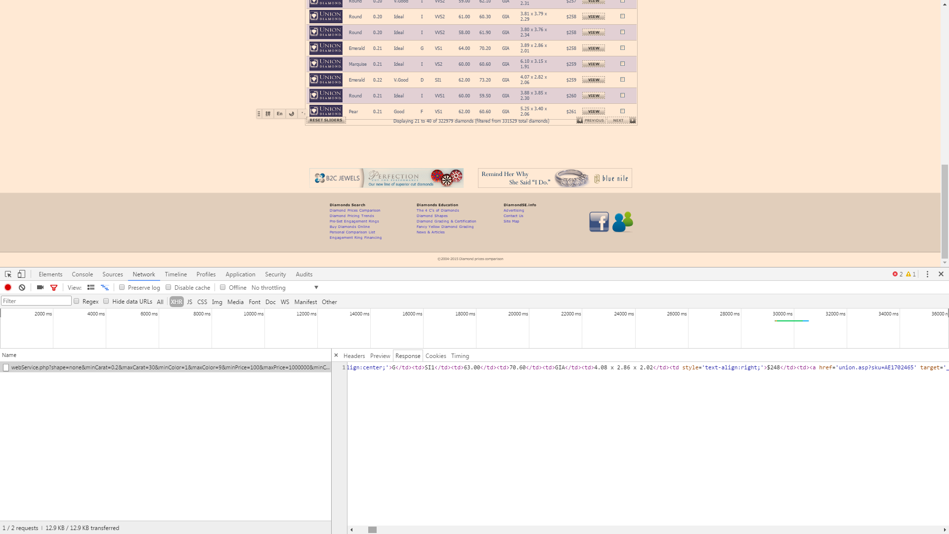
Scraping Data
open network (F12 in Chrome)
Ask new AJAX request
Analyze and obtain aimed address

Slide 10
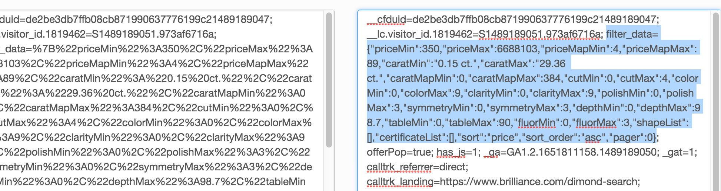
Scraping Data
Using PhantomJS to get html table
Change html table to CSV

Slide 11
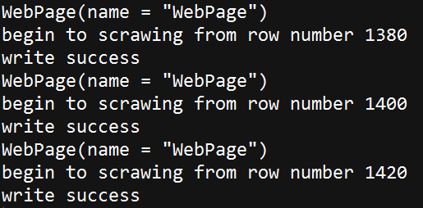
Scraping Data
Using PhantomJS to get html table
Change html table to CSV

Slide 12
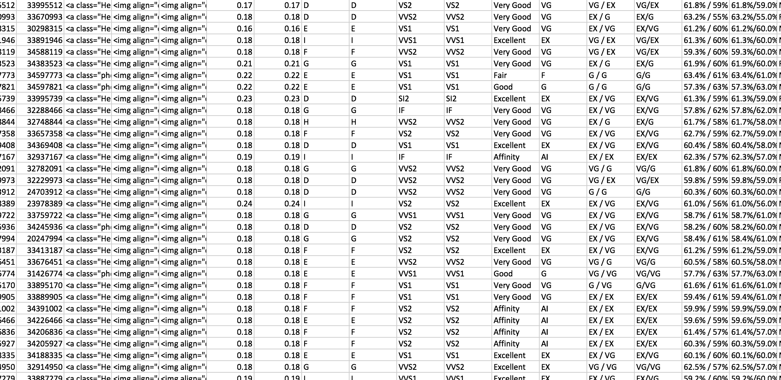
Data Cleaning
Delete useless class, split class, unify unit
Final: 13 attributes

Slide 13
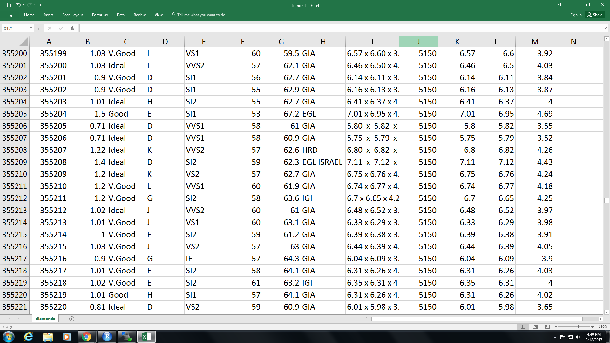
Data Cleaning
Delete useless class, split class, unify unit
Final: 13 attributes

Slide 14
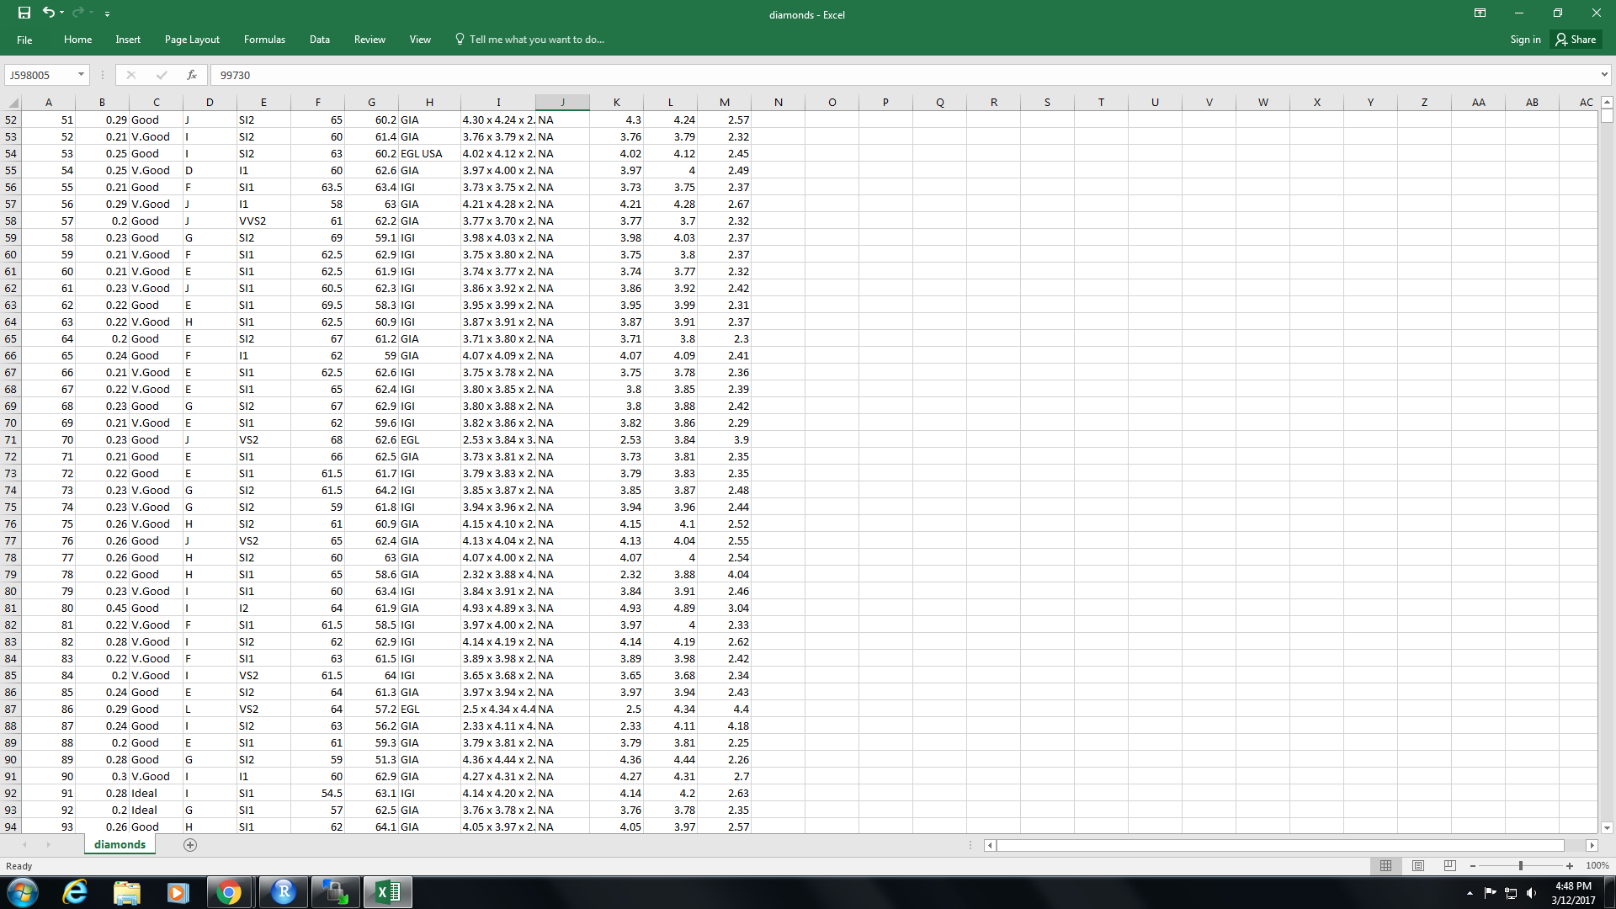
Data Treatment in R
Remove N/A (Not Available)
Remove index & measurement
Filter, trim & unique
Divide two data sets (train & test)

Slide 15
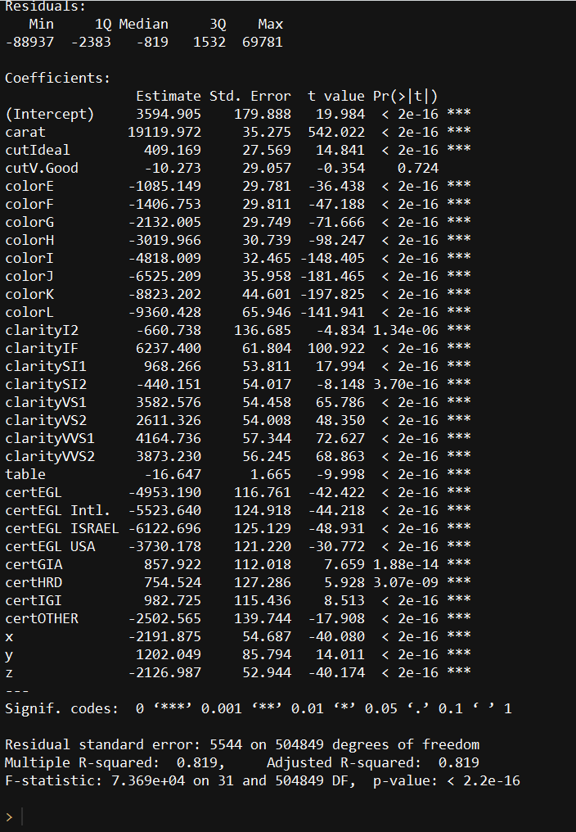
Multi-linear Regression
lm1=lm(price~., data=train)
summary(lm1)

Slide 16
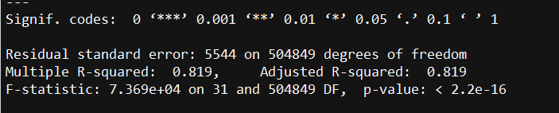
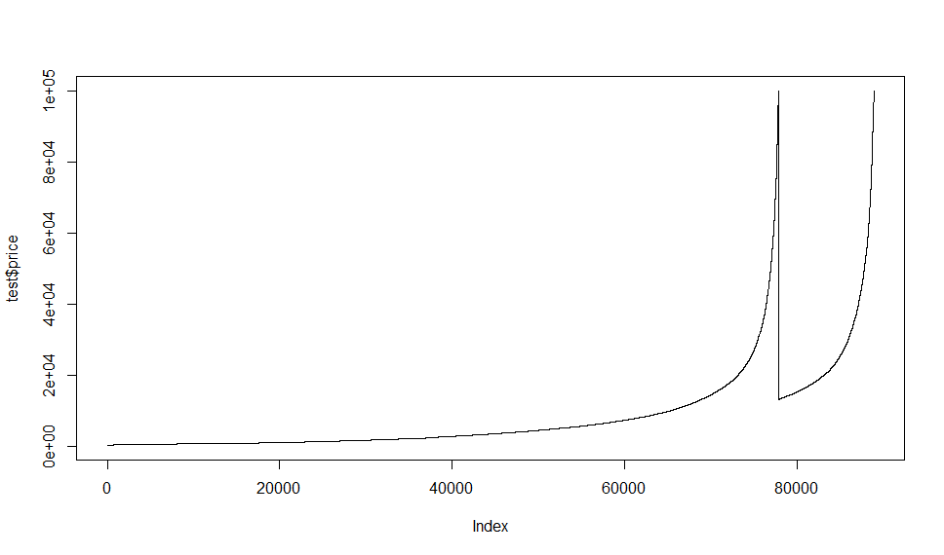
Multi-linear Regression
lm1=lm(price~., data=train)
summary(lm1)
steplm1=step(lm1)
summary(steplm1)

Slide 17
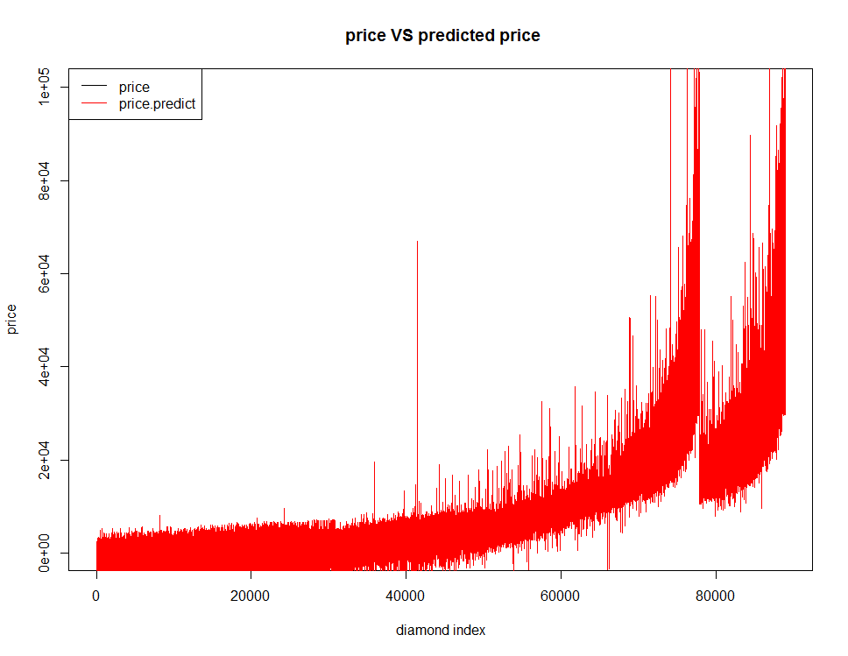
Multi-linear Regression
lm1=lm(price~., data=train)
summary(lm1)
steplm1=step(lm1)
summary(steplm1)

Slide 18
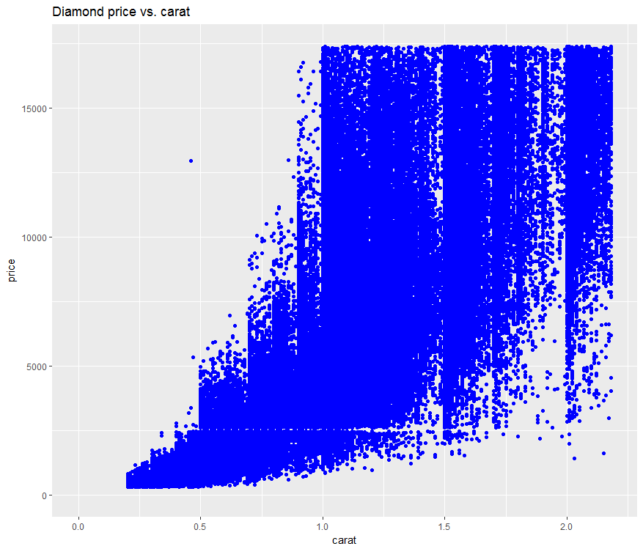
Multi-linear Regression
Relation between price and carat
Not linear enough

Slide 19
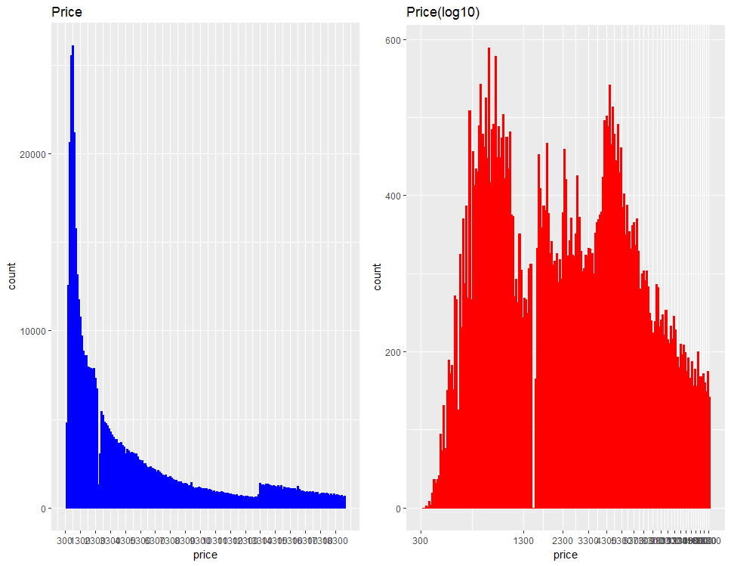
Multi-linear Regression
Huge range of price
Reduce range with log10()
Change carat with Cuberoot

Slide 20
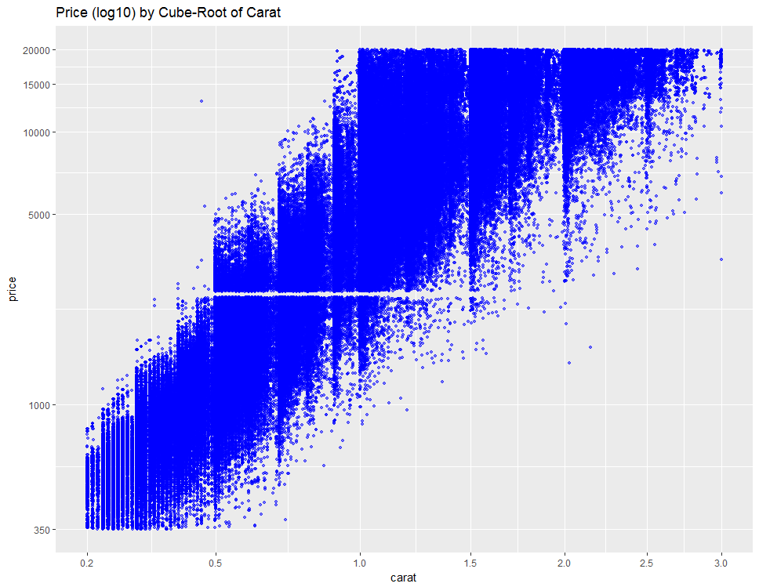
Multi-linear Regression
Huge range of price
Reduce range with log10()
Change carat with Cuberoot

Slide 21
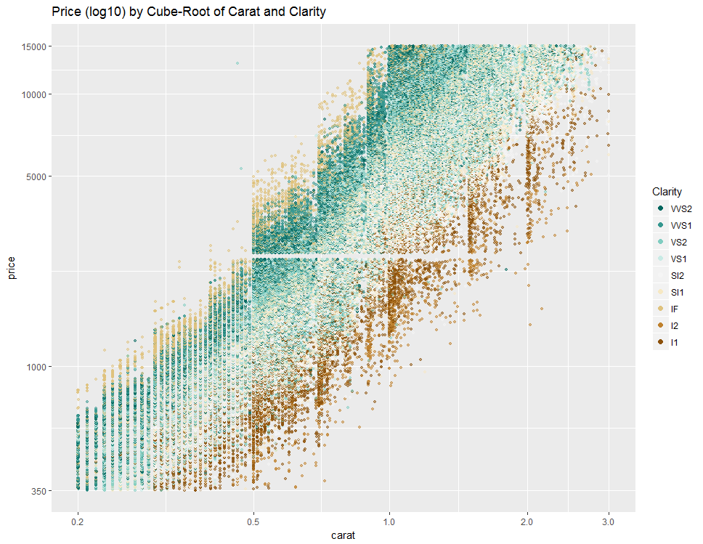
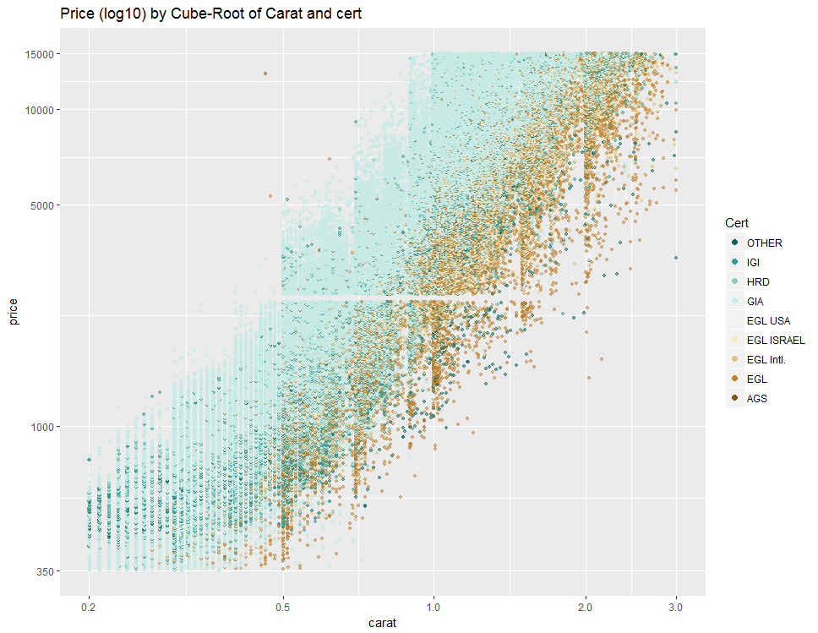
Multi-linear Regression

Slide 22
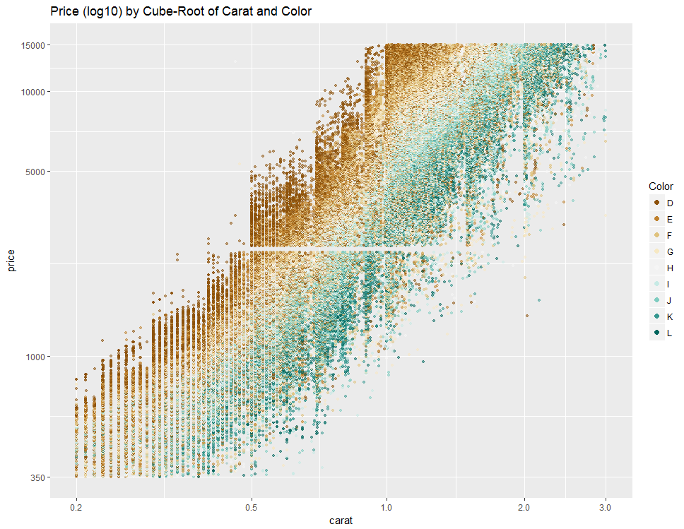
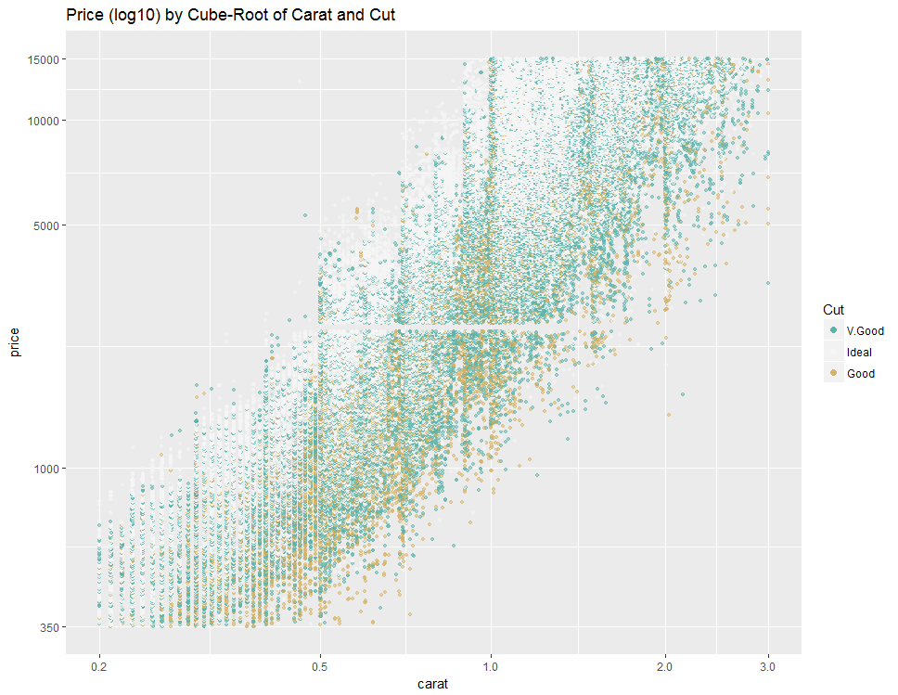
Multi-linear Regression

Slide 23
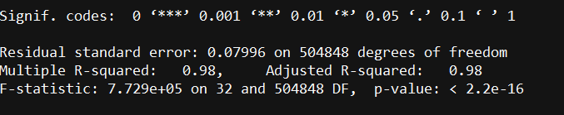
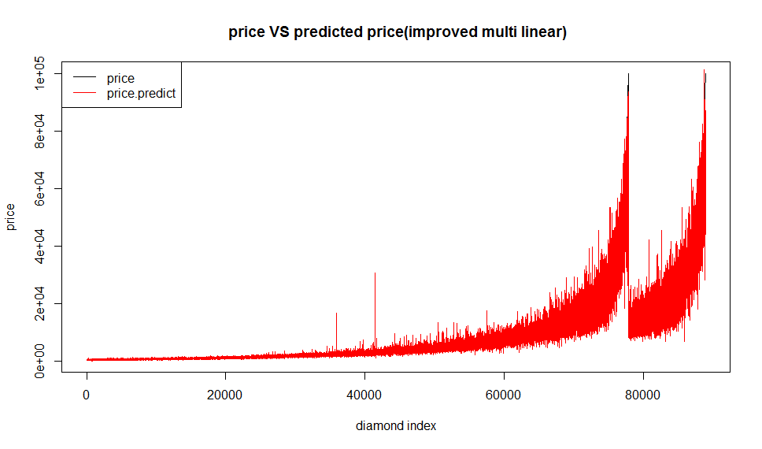
Multi-linear Regression
lm2 <- lm(I(log10(price)) ~I(carat^(1/3))+carat+cut+clarity+color+cert+x+y+z , data = train)
summary(lm2)
steplm2=step(lm2)
summary(steplm2)

Slide 24
Multi-linear Regression
Price=3594.91+19119.97carat+pc₁∗cut_{coef}+pc₂∗color_{coef}+pc₃∗clarity_{coef} +pc₄∗cert_{coef}-16.65table-2191.86x+1202.05y-2126.99z
Log(price)=0.28+3.28carat^{1/3}−0.36carat+pc₁∗cut_{coef}+pc₂∗color_{coef}+pc₃∗clarity_{coef} - pc₄∗cert_{coef} +0.01z
Pc ₁₋₄ means polynomial which represent each describable variables
Notes:
Need to modify

Slide 25
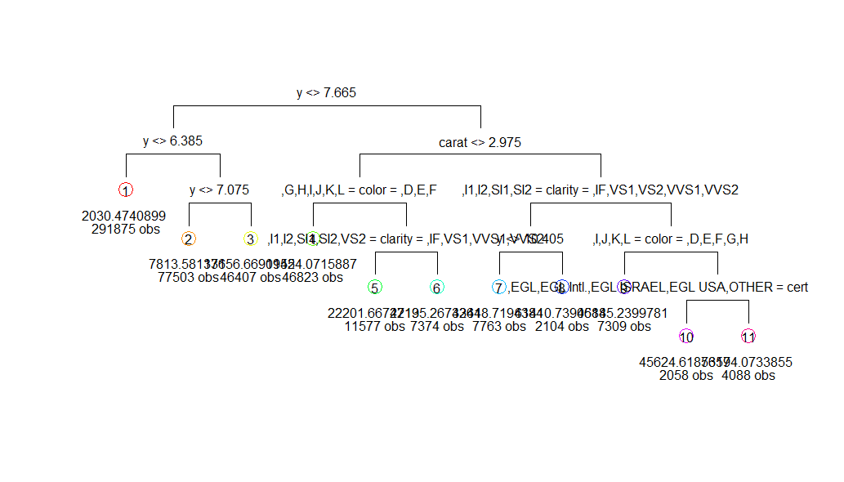
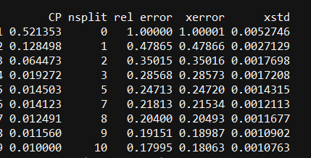
Decision Tree
tm3=tree(train$price~.,data=train)
tm4=rpart(price~.,data=train)
rsq.rpart(tm4)
tm4<- prune(tm4,cp=0.01)

Slide 26
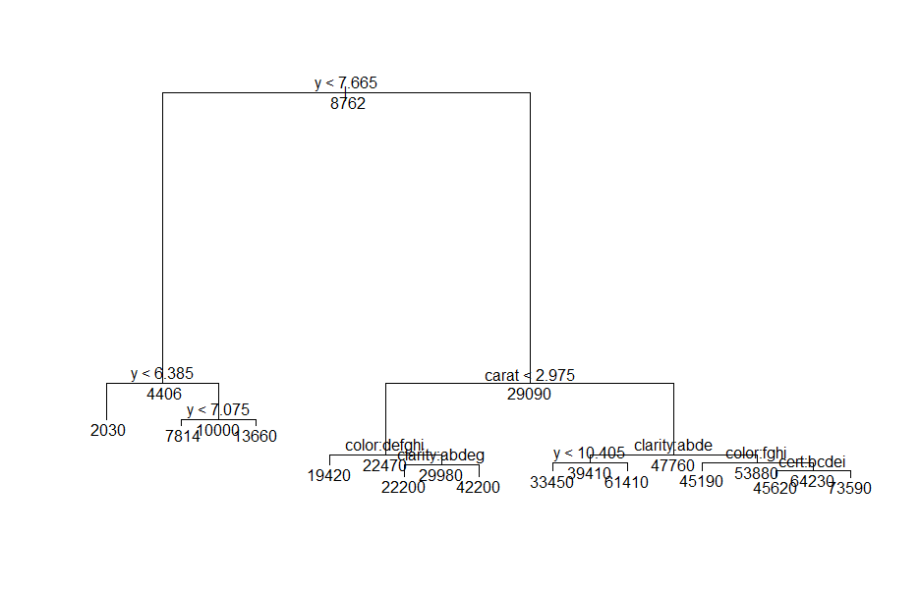
Decision Tree
tm3=tree(train$price~.,data=train)
tm4=rpart(price~.,data=train)
rsq.rpart(tm4)
tm4<- prune(tm4,cp=0.01)

Slide 27
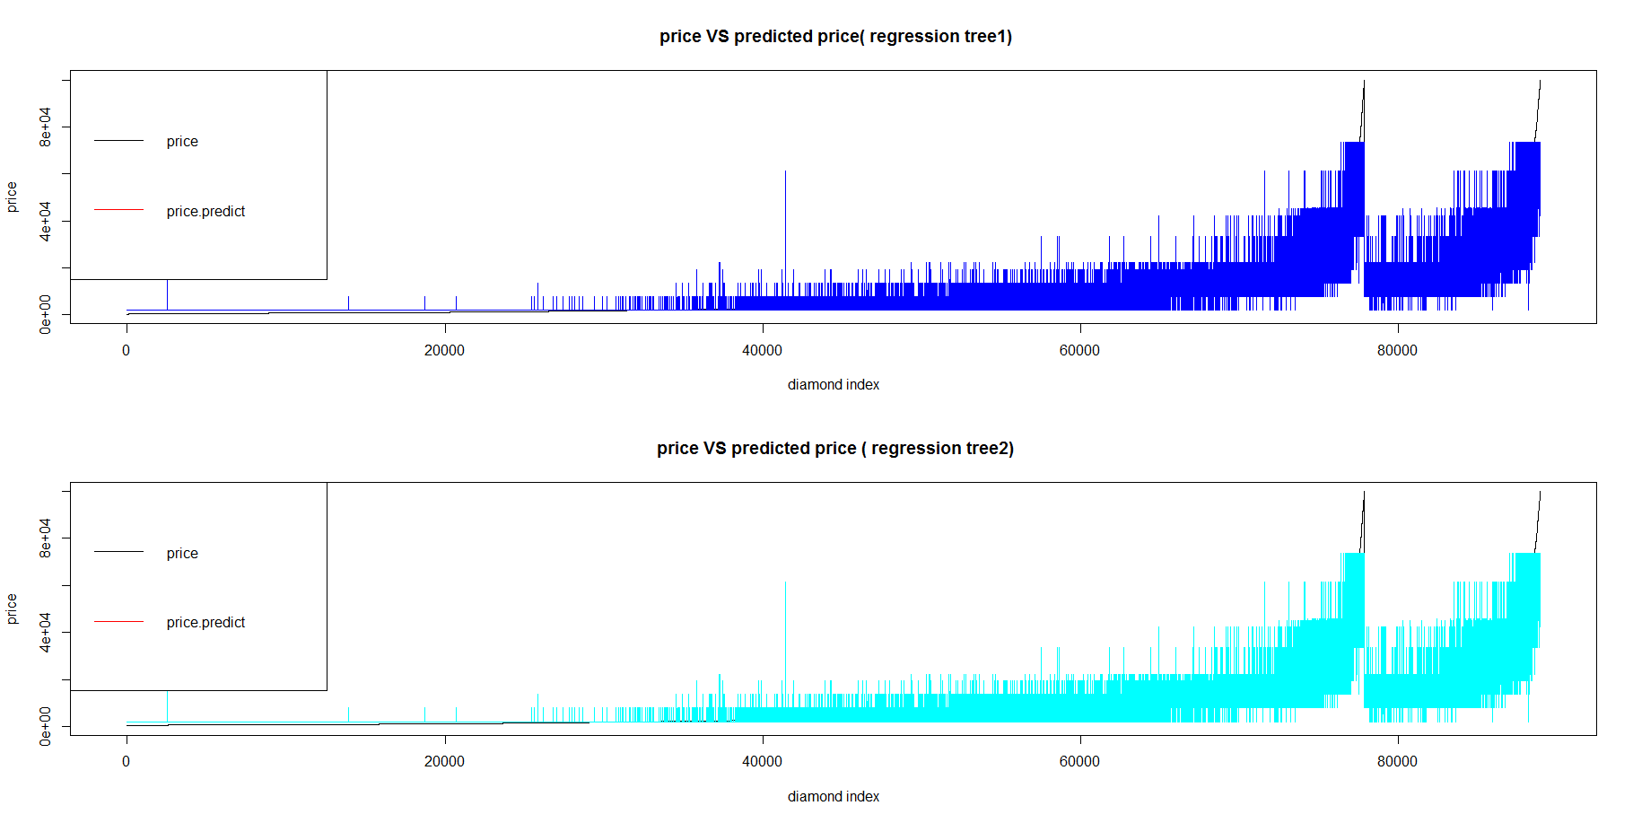
Decision Tree
tm3=tree(train$price~.,data=train)
tm4=rpart(price~.,data=train)
rsq.rpart(tm4)
tm4<- prune(tm4,cp=0.01)

Slide 28
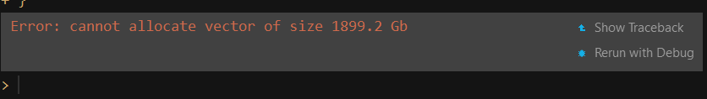
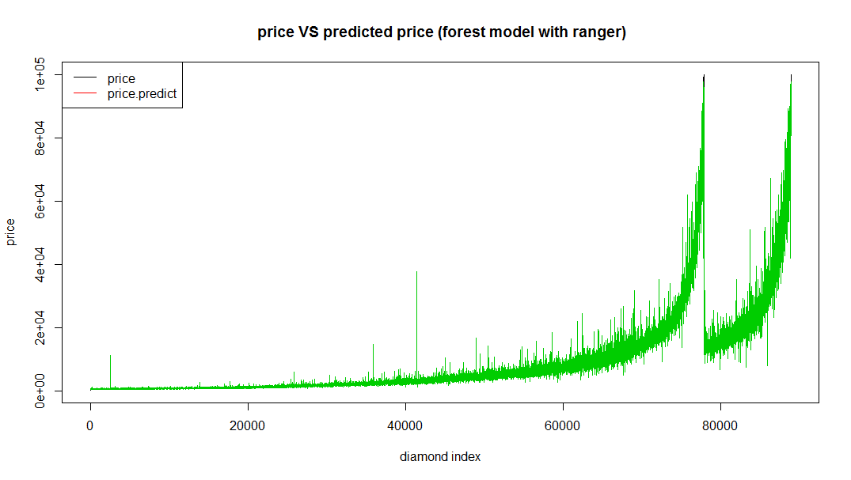
Random Forest
m =ncol(train)
for (i in 1:(m-1)){
test_model <- randomForest(price~.,data=train,mtry=i,importance=TRUE,
proximity=TRUE)
mse <- mean(test_model$mse)
print(mse)
}
fm5 <- ranger(price ~ ., data = train, write.forest = TRUE

Slide 29
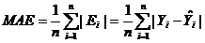
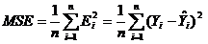
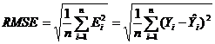
Model Evaluation
Mean AbsoluteError, MAE
Mean Squared Error, MSE
Root MeanSquaredError, RMSE

Slide 30
Model Evaluation
 | MAE | MSE | RMSE
lm1 | 3139.209 | 29991220 | 0.17822
lm2 | 1304.141 | 11261483 | 0.06692
tm3 | 3080.572 | 30934519 | 0.18383
tm4 | 3080.572 | 30934519 | 0.18383
fm5 | 506.0266 | 1608895 | 0.00956

Slide 31
Model Evaluation
 | MAE | MSE | RMSE
lm1 | 3139.209 | 29991220 | 0.17822
lm2 | 1304.141 | 11261483 | 0.06692
tm3 | 3080.572 | 30934519 | 0.18383
tm4 | 3080.572 | 30934519 | 0.18383
fm5 | 506.0266 | 1608895 | 0.00956
Random Forest Wins!

Slide 32

Conclusion
Limited knowledge about statistics
Improve the scraping to be total-automatic
Refine parameters & models

Slide 33
Reference
[1] Wang Y.-F. Predicting Stock Price Using Fuzzy Grey Prediction System. Expert Systems With Applications, 22(1), 33-38, 2002.
[2] Grolemund, G., & Wickham, H. R for Data Science.
[3] Jason Brownlee. April 8, 2016. Classification and Regression Tress for Machine Learning.
[4] StatisticsSolutions. What is Multiple Linear Regression.
[5] Statistic. Random Forests.
[6] The DataCamp Team. Short R tutorial: Scraping Javascript Generated Data with R.
[7] The DataCamp Team. Web Scraping with R and PhantomJS

Slide 34

Q&A

